Slide 1

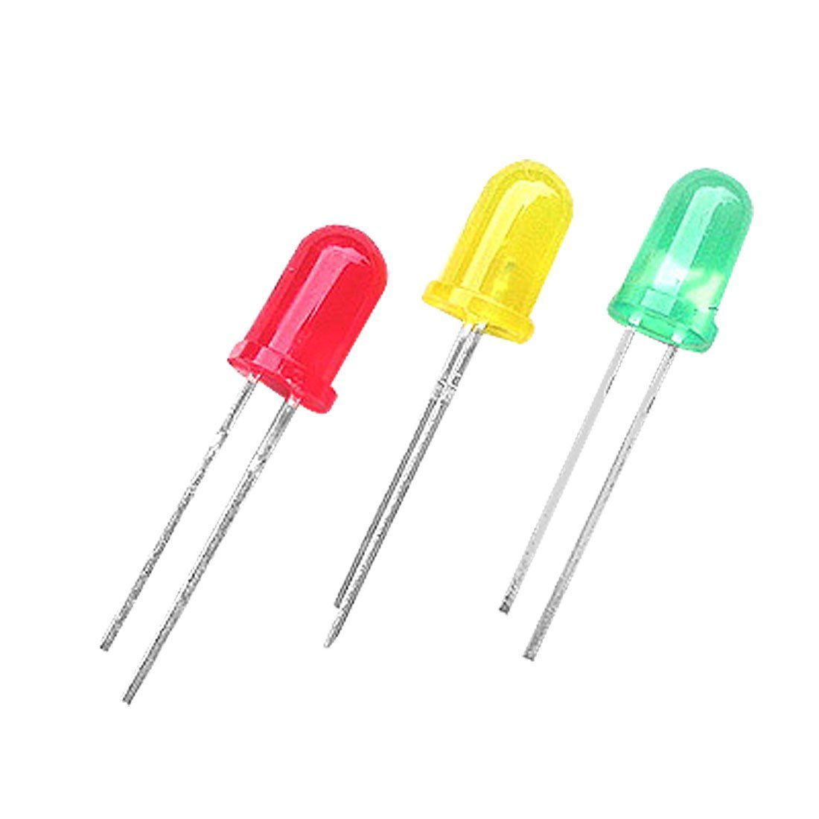
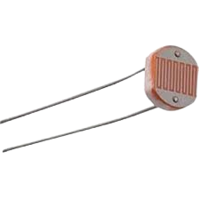
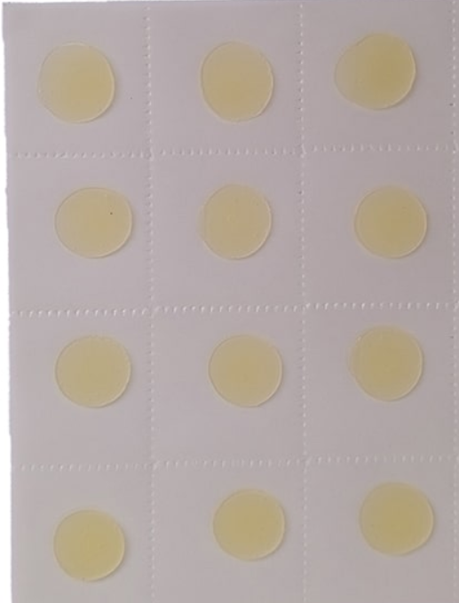
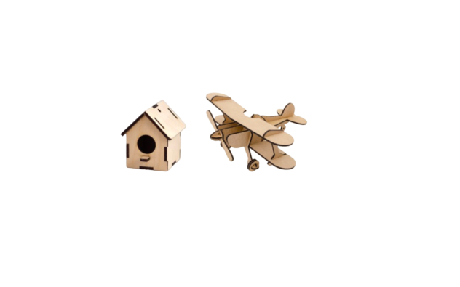
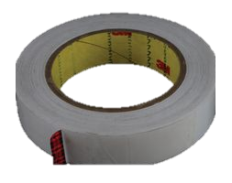
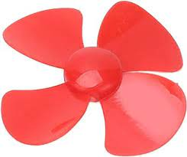
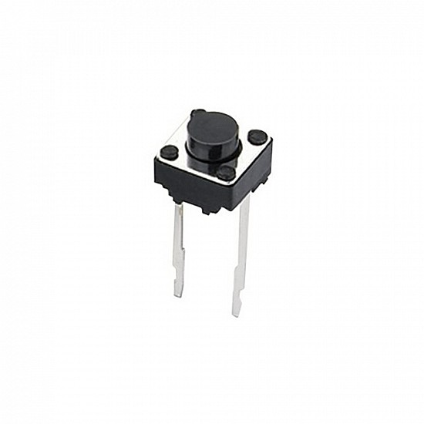
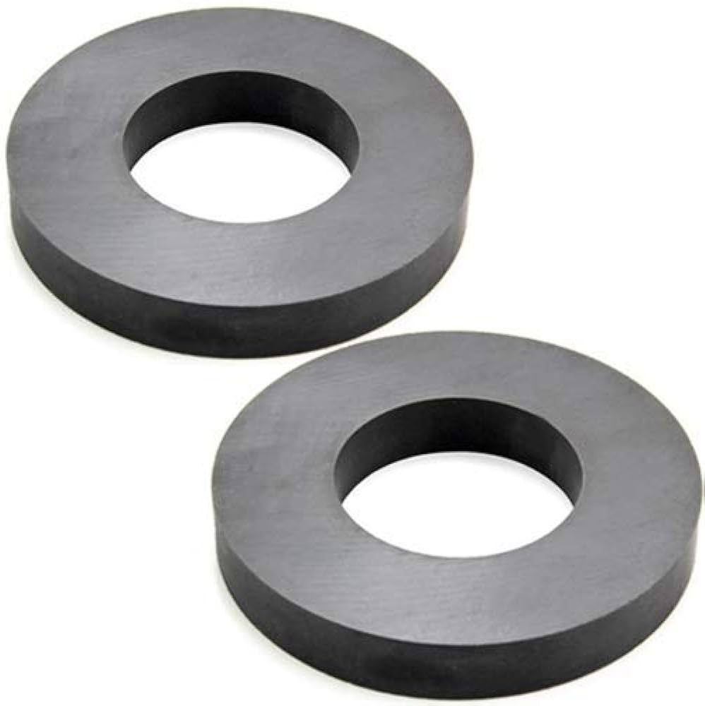
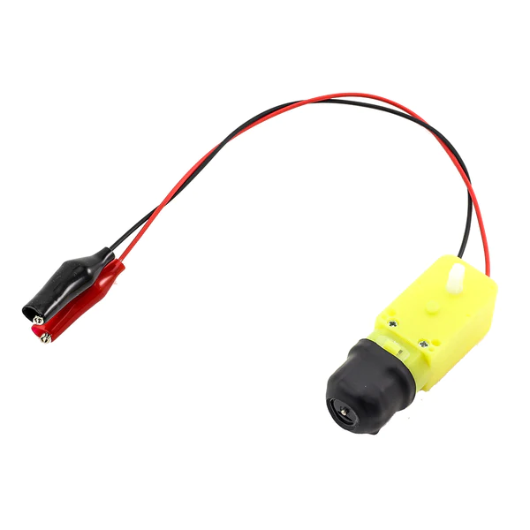
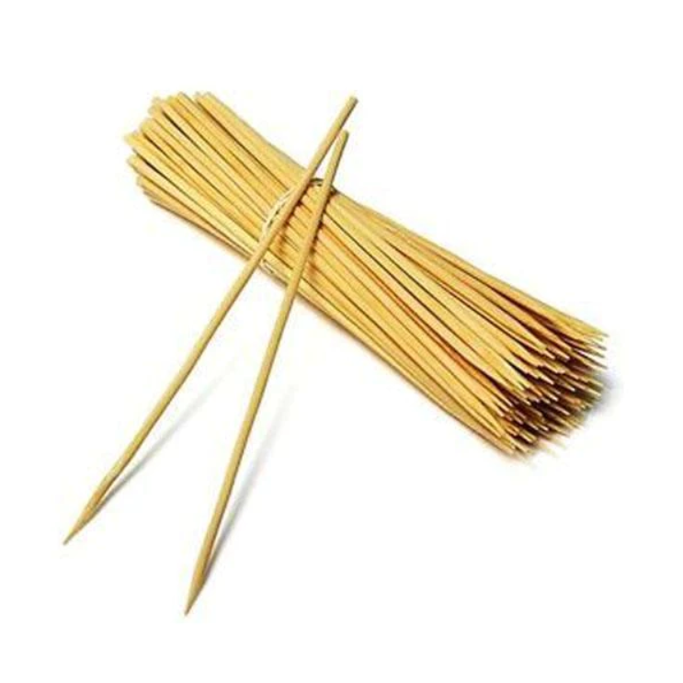

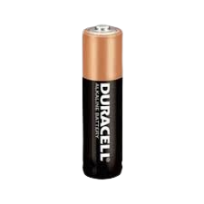
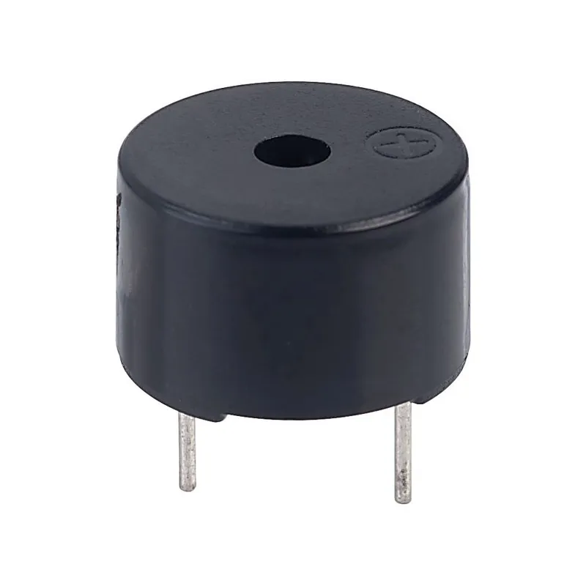
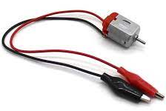
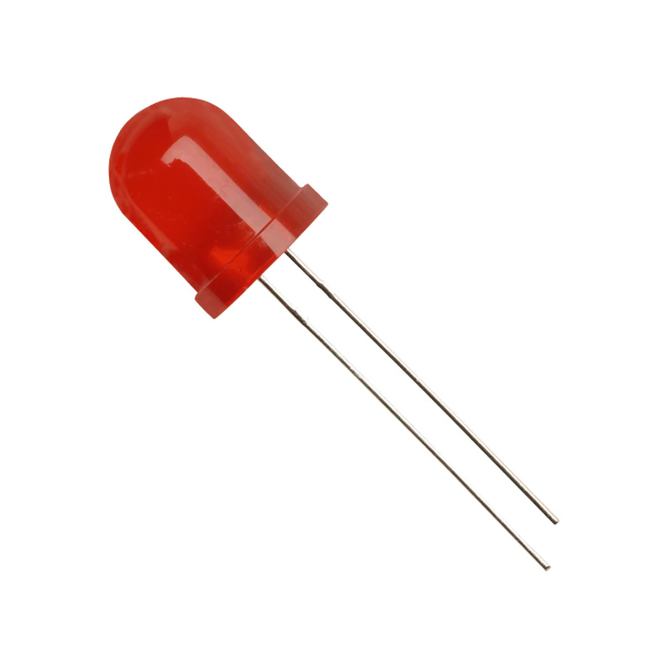
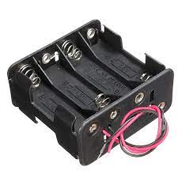
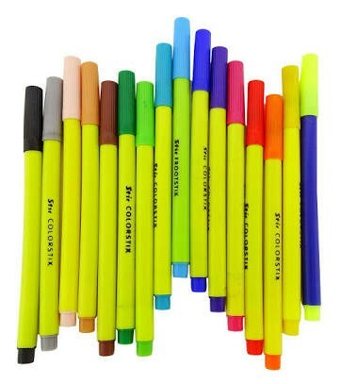
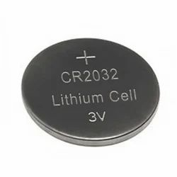
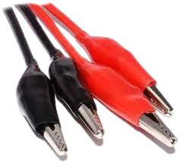
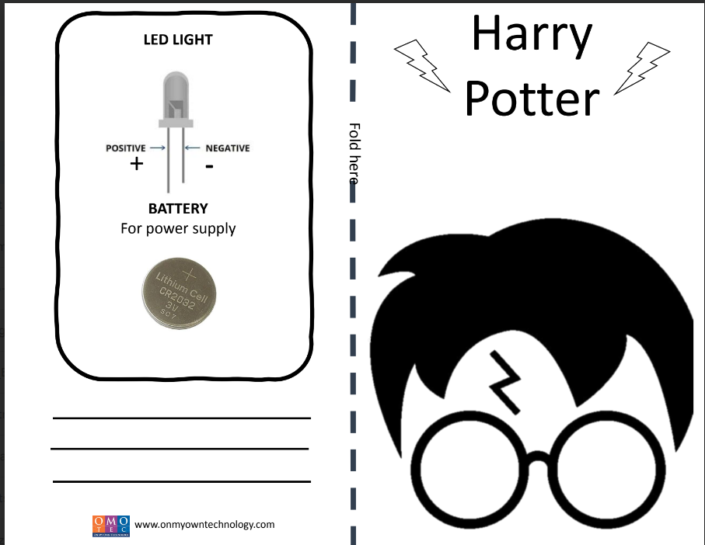
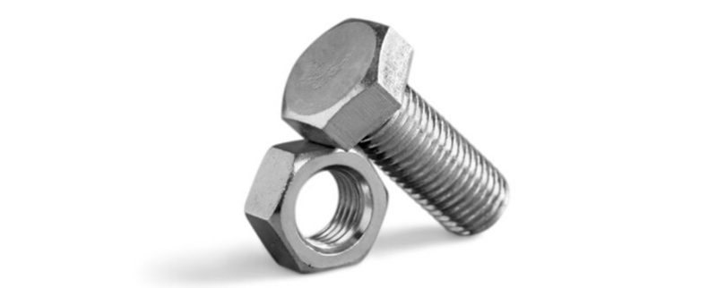
OMOTOOLS ROBOKRAFT KIT
List of Component
1. LEDs
15 pcs
5. Conductive Tape
1 pcs
9. Propeller
1 pcs
13. LDR
1 pcs
17. Glue Drop
24 pcs
21. MDF Sheet
32 pcs
2. Pushbutton
2 pcs
6. Magnet
2 pcs
10. BO Motor
1 pcs
14. String Wire
1 pcs
18. Bamboo Sticks
4 pcs
3. Buzzer Mini
1 pcs
7. Toy Motor
1 pcs
11. AA Battery
4 pcs
15.AA Battery Holder
1 pcs
19. Big Red LED
3 pcs
4. Sketch Pen
1 pcs
8.Coin Cell
2 pcs
12. Alligator Clip Wires
4 pcs
16. Circuit Paper
3 pcs
20. Screw & Bolt
4 pcs

Slide 2
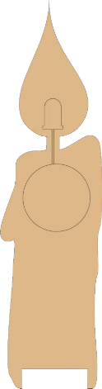
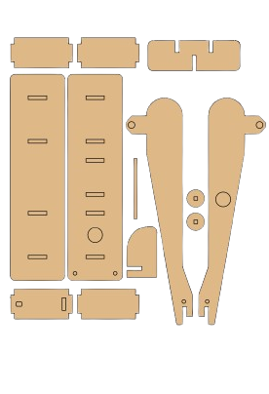
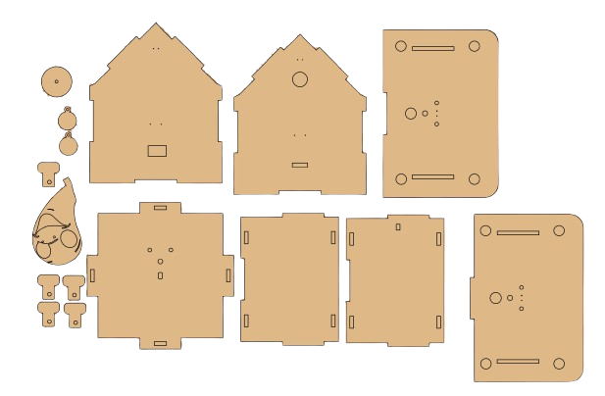
OMOTOOLS ROBOKRAFT Kit
Project to Implement
Sr. No. | Status | Project Name
1 |  | Light a Harry Potter Mark
2 |  | Auto-Rickshaw Horn
3 |  | Funny Penguin
4 |  | Glowing Candle
5 |  | Doodle Bot
6 |  | Table Fan
7 |  | Electric Maze Game
8 |  | Slow-Motion Casper
9 |  | Spin Master Art
10 |  | Ding-Dong Doorbell
11 |  | Magnetic Car
12 |  | Balloon Racer
13 |  | Power Generator
14 |  | Detect the Metal!
15 |  | Daybreak Monitor
16 |  | Drive Aircraft
MDF Cutouts
Connector pin
Wheels
Candle Plate
Tortoise
Connector 1
Connector 2
Connector 3
Base plate
Side plate 3
Up plate
Down plate
Wing 1
Wing 2
Side plate 1
Side plate 4
Side plate 2
Connector
6
Connector 4
Connector 5
Top plate 2
Top plate 1
Simple
Medium
Hard

Slide 3
OMOTOOLS ROBOKRAFT KIT
List of Component
1. LEDs
15 pcs
5. Conductive Tape
1 pcs
9. Propeller
1 pcs
13. LDR
1 pcs
17. Glue Drop
1 pcs
22. MDF Sheet
32 pcs
2. Pushbutton
2 pcs
6. Magnet
2 pcs
10. BO Motor
1 pcs
14. String Wire
1 pcs
18. Bamboo Sticks
4 pcs
3. Buzzer Mini
1 pcs
7. Toy Motor
1 pcs
11. AA Battery
4 pcs
15.AA Battery Holder
1 pcs
19. Big Red LED
3 pcs
4. Sketch Pen
1 pcs
8.Coin Cell
2 pcs
12. Alligator Clip Wires
4 pcs
16. Circuit Paper
3 pcs
20. Screw & Bolt
4 pcs

